Slide 1
Chapter 17 – Files and Streams
Outline
17.1 Introduction
17.2 Data Hierarchy
17.3 Files and Streams
17.4 Classes File and Directory
17.5 Creating a Sequential-Access File
17.6 Reading Data from a Sequential-Access File
17.7 Random-Access Files
17.8 Creating a Random-Access File
17.9 Writing Data Randomly to a Random-Access File
17.10 Reading Data Sequentially from a Random-Access File
17.11 Case Study: A Transaction-Processing Program

Slide 2
17.1 Introduction
Variables and arrays only temporary
  Lost during garbage collection or when a program terminates
Files used for long term storage
  Called persistent data
This chapter deals with:
  Sequential-access files
  Random-access files
  File processing features
  Stream-input/output features

Slide 3
17.2 Data Hierarchy
Data Hierarchy:
  Gets more complex as you move along:
    Bit: either one or zero
      All data represented as combination of bits
      Easy for electronic devices to understand
    Byte: eight bits
    Character: in C# two bytes
      Character set: set of all characters used to program and represent data on a particular computer
    Field: composition of characters that convey a meaning
    Record: composition of several, related fields
    File: group of related records
      Record key: identifies record to a particular entity
      Sequential file: records stored in order of record-key

Slide 4
17.2 Data Hierarchy
Sally
Black
Tom
Blue
Judy
Green
file
Iris
Orange
Randy
Red
Judy
Green
record
Judy
Field
01001010 byte (ASCII for J)
1 bit
Fig. 17.1 Data hierarchy.

Slide 5
17.3 Files and Streams
Files are sequential streams of bytes
  Ends with either an end-of-file marker or a specific byte
When file opened C#:
  Creates an object
  Associates a stream with that object
    Three stream objects:
      Console.In: returns standard input stream object
      Console.Out: returns standard output stream object
      Console.Error: returns standard error stream object
Namespace System.IO needed for file processing

Slide 6
17.3 Files and Streams
BinaryFormatter: used to serialize and deserialize objects
  Serialize:converting an object into a format that can be written to a file without losing data
  Deserialize: Reading formatted text from a file and reconstructing the original object from it
System.IO.Stream: allows representation of stream as bits
  FileStream: read to and write from sequential-access and random-access files
  MemoryStream:transfer of data directly to and from memory
  BufferedStream: uses buffer to transfer to memory

Slide 7
17.3 Files and Streams
1
2
3
4
5
6
7
8
9
……
n - 1
end of file marker
Fig. 17.2 C#’s view of an n-byte file.

Slide 8
17.4 Classes File and Directory
Information stored in files
  Files organized in directories
    Directory class used to manipulate directories
  File class used to manipulate files
    Only has static methods, cannot instantiate File objects

Slide 9
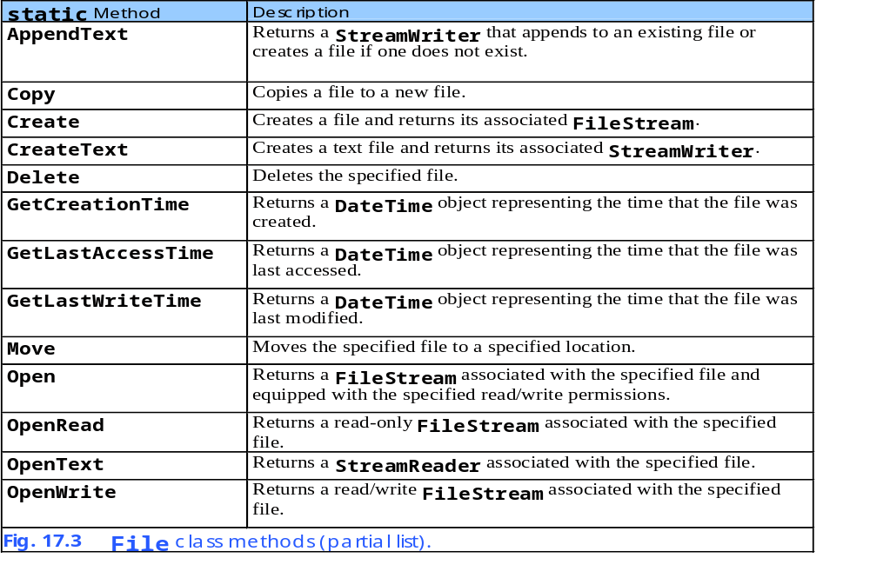
17.4 Classes File and Directory

Slide 10
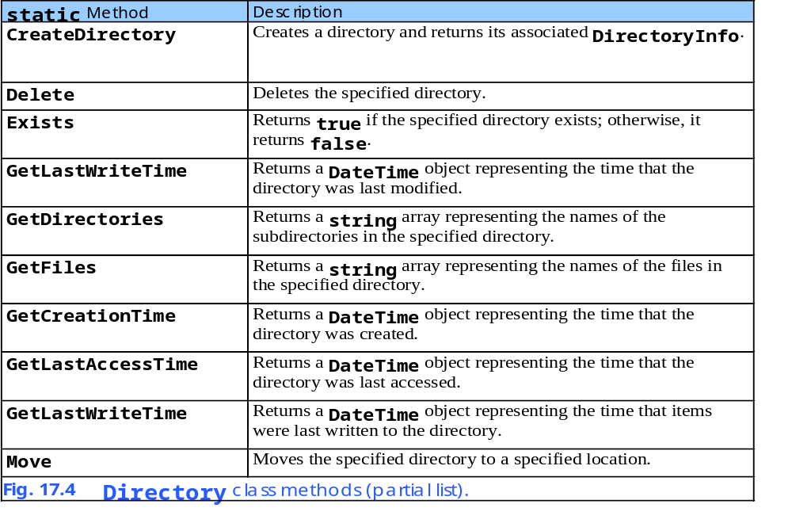
17.4 Classes File and Directory

Slide 11
FileTest.cs
1 // Fig 17.5: FileTest.cs
2 // Using classes File and Directory.
3
4 using System;
5 using System.Drawing;
6 using System.Collections;
7 using System.ComponentModel;
8 using System.Windows.Forms;
9 using System.Data;
10 using System.IO;
11
12 // displays contents of files and directories
13 public class FileTestForm : System.Windows.Forms.Form
14 {
15 private System.Windows.Forms.Label directionsLabel;
16
17 private System.Windows.Forms.TextBox outputTextBox;
18 private System.Windows.Forms.TextBox inputTextBox;
19
20 private System.ComponentModel.Container components = null;
21
22 [STAThread]
23 static void Main()
24 {
25 Application.Run( new FileTestForm() );
26 }
27
28 // Visual Studio .NET generated code
29
30 // invoked when user presses key
31 private void inputTextBox_KeyDown(
32 object sender, System.Windows.Forms.KeyEventArgs e )
33 {
Textbox for input of file or directory name
Event handler for keystrokes

Slide 12
FileTest.cs
34 // determine whether user pressed Enter key
35 if ( e.KeyCode == Keys.Enter )
36 {
37 string fileName; // name of file or directory
38
39 // get user-specified file or directory
40 fileName = inputTextBox.Text;
41
42 // determine whether fileName is a file
43 if ( File.Exists( fileName ) )
44 {
45 // get file's creation date,
46 // modification date, etc.
47 outputTextBox.Text = GetInformation( fileName );
48
49 // display file contents through StreamReader
50 try
51 {
52 // obtain reader and file contents
53 StreamReader stream = new StreamReader( fileName );
54 outputTextBox.Text += stream.ReadToEnd();
55 }
56 // handle exception if StreamReader is unavailable
57 catch( IOException )
58 {
59 MessageBox.Show( "File Error", "File Error",
60 MessageBoxButtons.OK, MessageBoxIcon.Error );
61 }
62 }
63
64 // determine whether fileName is a directory
65 else if ( Directory.Exists( fileName ) )
66 {
67 // array for directories
68 string[] directoryList;
Test if key typed was enter
Set fileName to what user typed
See if fileName is an existing file
If an existing file, get and output file information
Create StreamReader to read text from file
Call method ReadToEnd
Test if fileName is existing directory

Slide 13
FileTest.cs
69
70 // get directory's creation date,
71 // modification date, etc.
72 outputTextBox.Text = GetInformation( fileName );
73
74 // obtain file/directory list of specified directory
75 directoryList = Directory.GetDirectories( fileName );
76
77 outputTextBox.Text +=
78 "\r\n\r\nDirectory contents:\r\n";
79
80 // output directoryList contents
81 for ( int i = 0; i < directoryList.Length; i++ )
82 outputTextBox.Text += directoryList[ i ] + "\r\n";
83 }
84 else
85 {
86 // notify user that neither file nor directory exists
87 MessageBox.Show( inputTextBox.Text +
88 " does not exist", "File Error",
89 MessageBoxButtons.OK, MessageBoxIcon.Error );
90 }
91 } // end if
92
93 } // end method inputTextBox_KeyDown
94
95 // get information on file or directory
96 private string GetInformation( string fileName )
97 {
98 // output that file or directory exists
99 string information = fileName + " exists\r\n\r\n";
100
101 // output when file or directory was created
102 information += "Created: " +
103 File.GetCreationTime( fileName ) + "\r\n";
If it exists, get and output directory information
Get subdirectories
Output subdirectories
If user input is not existing file or directory output error message
Tell user file exists
Get file creation information

Slide 14
FileTest.cs
104
105 // output when file or directory was last modified
106 information += "Last modified: " +
107 File.GetLastWriteTime( fileName ) + "\r\n";
108
109 // output when file or directory was last accessed
110 information += "Last accessed: " +
111 File.GetLastAccessTime( fileName ) + "\r\n" + "\r\n";
112
113 return information;
114
115 } // end method GetInformation
116
117 } // end class FileTestForm
Get last time file was modified
Get last time file was accessed
Return file information

Slide 15
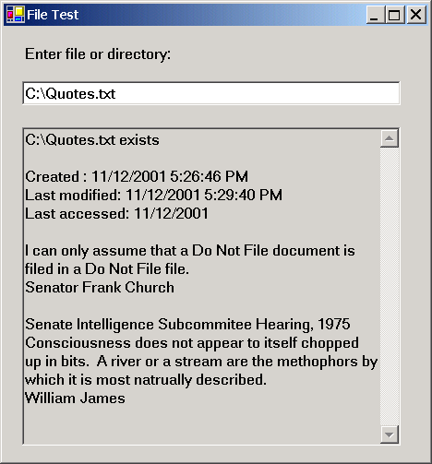
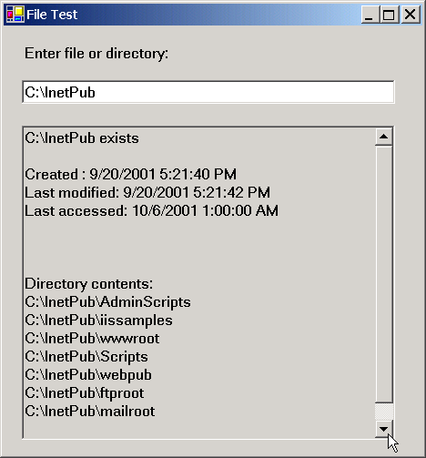
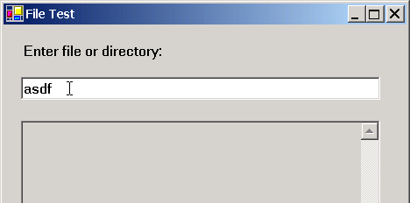
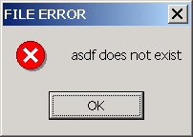
FileTest.cs
Program Output

Slide 16
FileSearch.cs
1 // Fig 17.6: FileSearch.cs
2 // Using regular expressions to determine file types.
3
4 using System;
5 using System.Drawing;
6 using System.Collections;
7 using System.ComponentModel;
8 using System.Windows.Forms;
9 using System.Data;
10 using System.IO;
11 using System.Text.RegularExpressions;
12 using System.Collections.Specialized;
13
14 public class FileSearchForm : System.Windows.Forms.Form
15 {
16 private System.Windows.Forms.Label directionsLabel;
17 private System.Windows.Forms.Label directoryLabel;
18
19 private System.Windows.Forms.Button searchButton;
20
21 private System.Windows.Forms.TextBox outputTextBox;
22 private System.Windows.Forms.TextBox inputTextBox;
23
24 private System.ComponentModel.Container components = null;
25
26 string currentDirectory = Directory.GetCurrentDirectory();
27 string[] directoryList; // subdirectories
28 string[] fileArray;
29
30 // store extensions found and number found
31 NameValueCollection found = new NameValueCollection();
32
Used to store type and number of each file extension

Slide 17
FileSearch.cs
33 [STAThread]
34 static void Main()
35 {
36 Application.Run( new FileSearchForm() );
37 }
38
39 // Visual Studio .NET generated code
40
41 // invoked when user types in text box
42 private void inputTextBox_KeyDown(
43 object sender, System.Windows.Forms.KeyEventArgs e )
44 {
45 // determine whether user pressed Enter
46 if ( e.KeyCode == Keys.Enter )
47 searchButton_Click( sender, e );
48
49 } // end method inputTextBox_KeyDown
50
51 // invoked when user clicks "Search Directory" button
52 private void searchButton_Click(
53 object sender, System.EventArgs e )
54 {
55 // check for user input; default is current directory
56 if ( inputTextBox.Text != "" )
57 {
58 // verify that user input is valid directory name
59 if ( Directory.Exists( inputTextBox.Text ) )
60 {
61 currentDirectory = inputTextBox.Text;
62
63 // reset input text box and update display
64 directoryLabel.Text = "Current Directory:" +
65 "\r\n" + currentDirectory;
66 }
Method to search recursively through directory path
Test if valid directory

Slide 18
FileSearch.cs
67 else
68 {
69 // show error if user does not specify valid directory
70 MessageBox.Show( "Invalid Directory", "Error",
71 MessageBoxButtons.OK, MessageBoxIcon.Error );
72 }
73 }
74
75 // clear text boxes
76 inputTextBox.Clear();
77 outputTextBox.Clear();
78
79 // search directory
80 SearchDirectory( currentDirectory );
81
82 // summarize and print results
83 foreach ( string current in found )
84 {
85 outputTextBox.Text += "* Found " +
86 found[ current ] + " " + current + " files.\r\n";
87 }
88
89 // clear output for new search
90 found.Clear();
91
92 } // end method searchButton_Click
93
94 // search directory using regular expression
95 private void SearchDirectory( string currentDirectory )
96 {
97 // search directory
98 try
99 {
100 string fileName = "";
101
If directory does not exist display error
If valid directory, call SearchDirectory
Display results of search

Slide 19
FileSearch.cs
102 // regular expression for extensions matching pattern
103 Regex regularExpression = new Regex(
104 "[a-zA-Z0-9]+\\.(?<extension>\\w+)" );
105
106 // stores regular-expression-match result
107 Match matchResult;
108
109 string fileExtension; // holds file extensions
110
111 // number of files with given extension in directory
112 int extensionCount;
113
114 // get directories
115 directoryList =
116 Directory.GetDirectories( currentDirectory );
117
118 // get list of files in current directory
119 fileArray = Directory.GetFiles( currentDirectory );
120
121 // iterate through list of files
122 foreach ( string myFile in fileArray )
123 {
124 // remove directory path from file name
125 fileName = myFile.Substring(
126 myFile.LastIndexOf( "\\" ) + 1 );
127
128 // obtain result for regular-expression search
129 matchResult = regularExpression.Match( fileName );
130
131 // check for match
132 if ( matchResult.Success )
133 fileExtension =
134 matchResult.Result( "${extension}" );
Define regularExpression as any file with extension
Get subdirectories
Get files of current directory
Search directory and subdirectory for bak files
Eliminate directory path to make comparison easier
Test if bak file
Store file extension

Slide 20
FileSearch.cs
135 else
136 fileExtension = "[no extension]";
137
138 // store value from container
139 if ( found[ fileExtension ] == null )
140 found.Add( fileExtension, "1" );
141 else
142 {
143 extensionCount = Int32.Parse(
144 found[ fileExtension ] ) + 1;
145
146 found[ fileExtension ] = extensionCount.ToString();
147 }
148
149 // search for backup(.bak) files
150 if ( fileExtension == "bak" )
151 {
152 // prompt user to delete (.bak) file
153 DialogResult result =
154 MessageBox.Show( "Found backup file " +
155 fileName + ". Delete?", "Delete Backup",
156 MessageBoxButtons.YesNo,
157 MessageBoxIcon.Question );
158
159 // delete file if user clicked 'yes'
160 if ( result == DialogResult.Yes )
161 {
162 File.Delete( myFile );
163
164 extensionCount =
165 Int32.Parse( found[ "bak" ] ) - 1;
166
If not a match, store no extension
Test if first time extension was found
If first time, add extension to list
If not first time, increment extension counter
Test if bak file
Ask if user wants to delete bak file
If yes, delete file, decrement count

Slide 21
FileSearch.cs
167 found[ "bak" ] = extensionCount.ToString();
168 }
169 }
170 }
171
172 // recursive call to search files in subdirectory
173 foreach ( string myDirectory in directoryList )
174 SearchDirectory( myDirectory );
175 }
176
177 // handle exception if files have unauthorized access
178 catch( UnauthorizedAccessException )
179 {
180 MessageBox.Show( "Some files may not be visible" +
181 " due to permission settings", "Warning",
182 MessageBoxButtons.OK, MessageBoxIcon.Information );
183 }
184
185 } // end method SearchDirectory
186
187 } // end class FileSearchForm
Search every subdirectory

Slide 22
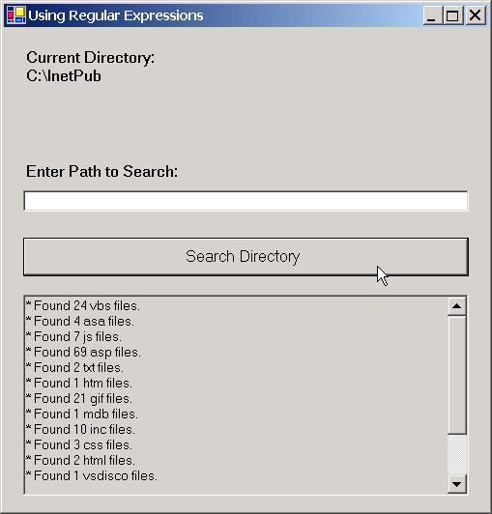
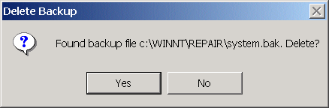
FileSearch.cs
Program Output

Slide 23
17.5 Creating a Sequential-Access File
Programmers have to structure files to meet the requirements of applications

Slide 24
BankUI.cs
1 // Fig 17.7: BankUI.cs
2 // A reusable windows form for the examples in this chapter.
3
4 using System;
5 using System.Drawing;
6 using System.Collections;
7 using System.ComponentModel;
8 using System.Windows.Forms;
9 using System.Data;
10
11 public class BankUIForm : System.Windows.Forms.Form
12 {
13 private System.ComponentModel.Container components = null;
14
15 public System.Windows.Forms.Label accountLabel;
16 public System.Windows.Forms.TextBox accountTextBox;
17
18 public System.Windows.Forms.Label firstNameLabel;
19 public System.Windows.Forms.TextBox firstNameTextBox;
20
21 public System.Windows.Forms.Label lastNameLabel;
22 public System.Windows.Forms.TextBox lastNameTextBox;
23
24 public System.Windows.Forms.Label balanceLabel;
25 public System.Windows.Forms.TextBox balanceTextBox;
26
27 // number of TextBoxes on Form'
28 protected int TextBoxCount = 4;
29
Textboxes
Labels

Slide 25
BankUI.cs
30 // enumeration constants specify TextBox indices
31 public enum TextBoxIndices
32 {
33 ACCOUNT,
34 FIRST,
35 LAST,
36 BALANCE
37
38 } // end enum
39
40 [STAThread]
41 static void Main()
42 {
43 Application.Run( new BankUIForm() );
44 }
45
46 // Visual Studio .NET generated code
47
48 // clear all TextBoxes
49 public void ClearTextBoxes()
50 {
51 // iterate through every Control on form
52 for ( int i = 0; i < Controls.Count; i++ )
53 {
54 Control myControl = Controls[ i ]; // get control
55
56 // determine whether Control is TextBox
57 if ( myControl is TextBox )
58 {
59 // clear Text property (set to empty strng)
60 myControl.Text = "";
61 }
62 }
63
64 } // end method ClearTextBoxes
Method to clear textboxes

Slide 26
BankUI.cs
65
66 // set text box values to string array values
67 public void SetTextBoxValues( string[] values )
68 {
69 // determine whether string array has correct length
70 if ( values.Length != TextBoxCount )
71 {
72 // throw exception if not correct length
73 throw( new ArgumentException( "There must be " +
74 (TextBoxCount + 1) + " strings in the array" ) );
75 }
76
77 // set array values if array has correct length
78 else
79 {
80 // set array values to text box values
81 accountTextBox.Text =
82 values[ ( int )TextBoxIndices.ACCOUNT ];
83 firstNameTextBox.Text =
84 values[ ( int )TextBoxIndices.FIRST ];
85 lastNameTextBox.Text =
86 values[ ( int )TextBoxIndices.LAST ];
87 balanceTextBox.Text =
88 values[ ( int )TextBoxIndices.BALANCE ];
89 }
90
91 } // end method SetTextBoxValues
92
93 // return text box values as string array
94 public string[] GetTextBoxValues()
95 {
96 string[] values = new string[ TextBoxCount ];
97
Method to set values of textboxes
Method to get the values of textboxes

Slide 27
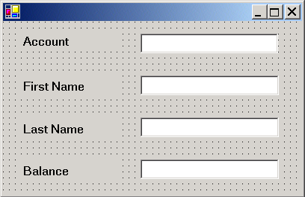
BankUI.cs
Program Output
98 // copy text box fields to string array
99 values[ ( int )TextBoxIndices.ACCOUNT ] =
100 accountTextBox.Text;
101 values[ ( int )TextBoxIndices.FIRST ] =
102 firstNameTextBox.Text;
103 values[ ( int )TextBoxIndices.LAST ] =
104 lastNameTextBox.Text;
105 values[ ( int )TextBoxIndices.BALANCE ] =
106 balanceTextBox.Text;
107
108 return values;
109
110 } // end method GetTextBoxValues
111
112 } // end class BankUIForm

Slide 28
Record.cs
1 // Fig. 17.8: Record.cs
2 // Serializable class that represents a data record.
3
4 using System;
5
6 [Serializable]
7 public class Record
8 {
9 private int account;
10 private string firstName;
11 private string lastName;
12 private double balance;
13
14 // default constructor sets members to default values
15 public Record() : this( 0, "", "", 0.0 )
16 {
17 }
18
19 // overloaded constructor sets members to parameter values
20 public Record( int accountValue, string firstNameValue,
21 string lastNameValue, double balanceValue )
22 {
23 Account = accountValue;
24 FirstName = firstNameValue;
25 LastName = lastNameValue;
26 Balance = balanceValue;
27
28 } // end constructor
29
Tells compiler objects of class Record can be represented as a set of bits
Data to go into record
Sets members to 0
Set members to parameters

Slide 29
Record.cs
30 // property Account
31 public int Account
32 {
33 get
34 {
35 return account;
36 }
37
38 set
39 {
40 account = value;
41 }
42
43 } // end property Account
44
45 // property FirstName
46 public string FirstName
47 {
48 get
49 {
50 return firstName;
51 }
52
53 set
54 {
55 firstName = value;
56 }
57
58 } // end property FirstName
59
Accessor methods

Slide 30
Record.cs
60 // property LastName
61 public string LastName
62 {
63 get
64 {
65 return lastName;
66 }
67
68 set
69 {
70 lastName = value;
71 }
72
73 } // end property LastName
74
75 // property Balance
76 public double Balance
77 {
78 get
79 {
80 return balance;
81 }
82
83 set
84 {
85 balance = value;
86 }
87
88 } // end property Balance
89
90 } // end class Record
Accessor methods

Slide 31
CreateSequentialAccessFile.cs
1 // Fig 17.9: CreateSequentialAccessFile.cs
2 // Creating a sequential-access file.
3
4 // C# namespaces
5 using System;
6 using System.Drawing;
7 using System.Collections;
8 using System.ComponentModel;
9 using System.Windows.Forms;
10 using System.Data;
11 using System.IO;
12 using System.Runtime.Serialization.Formatters.Binary;
13 using System.Runtime.Serialization;
14
15 // Deitel namespace
16 using BankLibrary;
17
18 public class CreateFileForm : BankUIForm
19 {
20 private System.Windows.Forms.Button saveButton;
21 private System.Windows.Forms.Button enterButton;
22 private System.Windows.Forms.Button exitButton;
23
24 private System.ComponentModel.Container components = null;
25
26 // serializes Record in binary format
27 private BinaryFormatter formatter = new BinaryFormatter();
28
29 // stream through which serializable data is written to file
30 private FileStream output;
31

Slide 32
CreateSequentialAccessFile.cs
32 [STAThread]
33 static void Main()
34 {
35 Application.Run( new CreateFileForm() );
36 }
37
38 // Visual Studio .NET generated code
39
40 // invoked when user clicks Save button
41 private void saveButton_Click(
42 object sender, System.EventArgs e )
43 {
44 // create dialog box enabling user to save file
45 SaveFileDialog fileChooser = new SaveFileDialog();
46 DialogResult result = fileChooser.ShowDialog();
47 string fileName; // name of file to save data
48
49 // allow user to create file
50 fileChooser.CheckFileExists = false;
51
52 // exit event handler if user clicked "Cancel"
53 if ( result == DialogResult.Cancel )
54 return;
55
56 // get specified file name
57 fileName = fileChooser.FileName;
58
59 // show error if user specified invalid file
60 if ( fileName == "" || fileName == null )
61 MessageBox.Show( "Invalid File Name", "Error",
62 MessageBoxButtons.OK, MessageBoxIcon.Error );
Instantiate SaveFileDialog object
Show SaveFileDialog
Test if user canceled save
Get file name to save to

Slide 33
CreateSequentialAccessFile.cs
63 else
64 {
65 // save file via FileStream if user specified valid file
66 try
67 {
68 // open file with write access
69 output = new FileStream( fileName,
70 FileMode.OpenOrCreate, FileAccess.Write );
71
72 // disable Save button and enable Enter button
73 saveButton.Enabled = false;
74 enterButton.Enabled = true;
75 }
76
77 // handle exception if file does not exist
78 catch ( FileNotFoundException )
79 {
80 // notify user if file does not exist
81 MessageBox.Show( "File Does Not Exist", "Error",
82 MessageBoxButtons.OK, MessageBoxIcon.Error );
83 }
84 }
85 } // end method saveButton_Click
86
87 // invoke when user clicks Enter button
88 private void enterButton_Click(
89 object sender, System.EventArgs e )
90 {
91 // store TextBox values string array
92 string[] values = GetTextBoxValues();
93
94 // Record containing TextBox values to serialize
95 Record record = new Record();
96
Instantiate output stream with write permission
Method to save data when user clicks enter

Slide 34
CreateSequentialAccessFile.cs
97 // determine whether TextBox account field is empty
98 if ( values[ ( int )TextBoxIndices.ACCOUNT ] != "" )
99 {
100 // store TextBox values in Record and serialize Record
101 try
102 {
103 // get account number value from TextBox
104 int accountNumber = Int32.Parse(
105 values[ ( int )TextBoxIndices.ACCOUNT ] );
106
107 // determine whether accountNumber is valid
108 if ( accountNumber > 0 )
109 {
110 // store TextBox fields in Record
111 record.Account = accountNumber;
112 record.FirstName =
113 values[ ( int )TextBoxIndices.FIRST ];
114 record.LastName =
115 values[ ( int )TextBoxIndices.LAST ];
116 record.Balance = Double.Parse( values[
117 ( int )TextBoxIndices.BALANCE ] );
118
119 // write Record to FileStream (serialize object)
120 formatter.Serialize( output, record );
121 }
122 else
123 {
124 // notify user if invalid account number
125 MessageBox.Show( "Invalid Account Number", "Error",
126 MessageBoxButtons.OK, MessageBoxIcon.Error );
127 }
128 }
129
Store TextBox fields in record
Write data to file

Slide 35
CreateSequentialAccessFile.cs
130 // notify user if error occurs in serialization
131 catch( SerializationException )
132 {
133 MessageBox.Show( "Error Writing to File", "Error",
134 MessageBoxButtons.OK, MessageBoxIcon.Error );
135 }
136
137 // notify user if error occurs regarding parameter format
138 catch( FormatException )
139 {
140 MessageBox.Show( "Invalid Format", "Error",
141 MessageBoxButtons.OK, MessageBoxIcon.Error );
142 }
143 }
144
145 ClearTextBoxes(); // clear TextBox values
146
147 } // end method enterButton_Click
148
149 // invoked when user clicks Exit button
150 private void exitButton_Click(
151 object sender, System.EventArgs e )
152 {
153 // determine whether file exists
154 if ( output != null )
155 {
156 // close file
157 try
158 {
159 output.Close();
160 }
161
Catch block if user input invalid data
Close FileStream

Slide 36
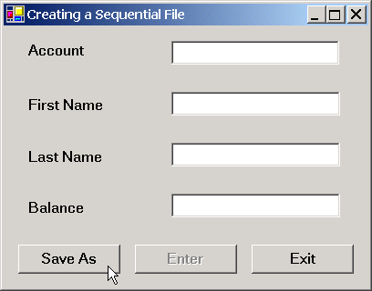
CreateSequentialAccessFile.cs
Program Output
162 // notify user of error closing file
163 catch( IOException )
164 {
165 MessageBox.Show( "Cannot close file", "Error",
166 MessageBoxButtons.OK, MessageBoxIcon.Error );
167 }
168 }
169
170 Application.Exit();
171
172 } // end method exitButton_Click
173
174 } // end class CreateFileForm
Exit program
BankUI graphical user interface

Slide 37
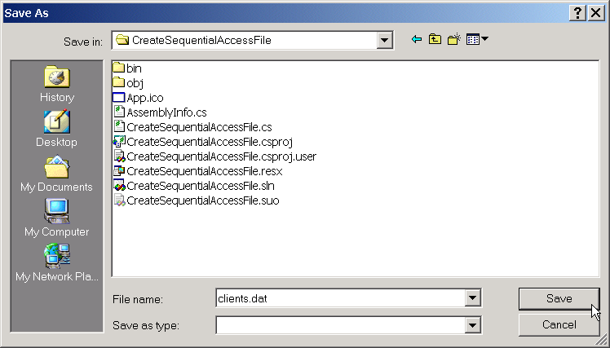
CreateSequentialAccessFile.cs
Program Output
SaveFileDialogue
Files and directories

Slide 38
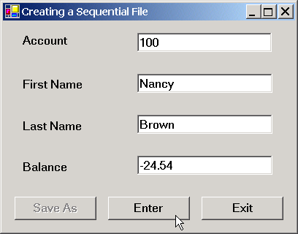
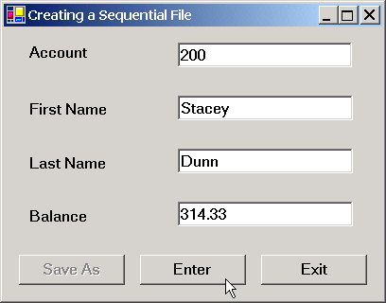
CreateSequentialAccessFile.cs
Program Output

Slide 39
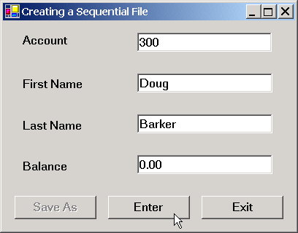
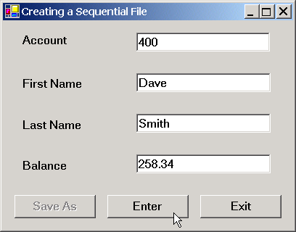
CreateSequentialAccessFile.cs
Program Output

Slide 40

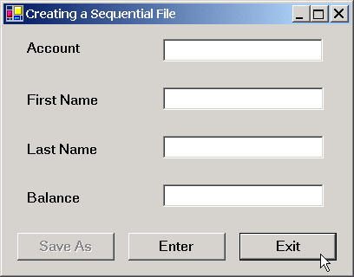
CreateSequentialAccessFile.cs
Program Output

Slide 41
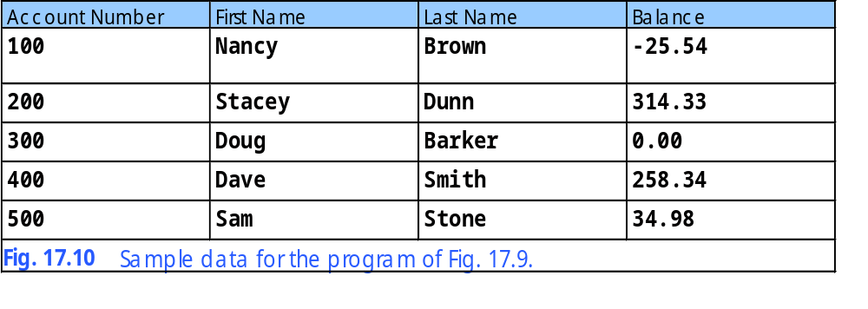
17.5 Creating a Sequential-Access File

Slide 42
17.6 Reading Data from a Sequential-Access File
Read data sequentially from a file
  Programs usually start at beginning of file and read data consecutively until the desired data is found
    Sometimes necessary to do this several times during execution of a program
  File-position pointer:
    Points to next byte to be read from or written to file
    Can be repositioned to any point in file
RichTextBox:
  LoadFile: method to display file contents
  Find: method for searching individual strings
  Can display multiple lines of text

Slide 43
ReadSequentialAccessFile.cs
1 // Fig. 17.11: ReadSequentialAccessFile.cs
2 // Reading a sequential-access file.
3
4 // C# namespaces
5 using System;
6 using System.Drawing;
7 using System.Collections;
8 using System.ComponentModel;
9 using System.Windows.Forms;
10 using System.Data;
11 using System.IO;
12 using System.Runtime.Serialization.Formatters.Binary;
13 using System.Runtime.Serialization;
14
15 // Deitel namespaces
16 using BankLibrary;
17
18 public class ReadSequentialAccessFileForm : BankUIForm
19 {
20 System.Windows.Forms.Button openButton;
21 System.Windows.Forms.Button nextButton;
22
23 private System.ComponentModel.Container components = null;
24
25 // stream through which serializable data are read from file
26 private FileStream input;
27
28 // object for deserializing Record in binary format
29 private BinaryFormatter reader = new BinaryFormatter();
30
31 [STAThread]
32 static void Main()
33 {
34 Application.Run( new ReadSequentialAccessFileForm() );
35 }

Slide 44
ReadSequentialAccessFile.cs
36
37 // Visual Studio .NET generated code
38
39 // invoked when user clicks Open button
40 private void openButton_Click(
41 object sender, System.EventArgs e )
42 {
43 // create dialog box enabling user to open file
44 OpenFileDialog fileChooser = new OpenFileDialog();
45 DialogResult result = fileChooser.ShowDialog();
46 string fileName; // name of file containing data
47
48 // exit event handler if user clicked Cancel
49 if ( result == DialogResult.Cancel )
50 return;
51
52 // get specified file name
53 fileName = fileChooser.FileName;
54 ClearTextBoxes();
55
56 // show error if user specified invalid file
57 if ( fileName == "" || fileName == null )
58 MessageBox.Show( "Invalid File Name", "Error",
59 MessageBoxButtons.OK, MessageBoxIcon.Error );
60 else
61 {
62 // create FileStream to obtain read access to file
63 input = new FileStream( fileName, FileMode.Open,
64 FileAccess.Read );
65
66 // enable next record button
67 nextButton.Enabled = true;
68 }
69
70 } // end method openButton_Click
Instantiate OpenFilelDialog
Display OpenFileDialog
Create FileStream object for input with read only perimission

Slide 45
ReadSequentialAccessFile.cs
71
72 // invoked when user clicks Next button
73 private void nextButton_Click(
74 object sender, System.EventArgs e )
75 {
76 // deserialize Record and store data in TextBoxes
77 try
78 {
79 // get next Record available in file
80 Record record =
81 ( Record )reader.Deserialize( input );
82
83 // store Record values in temporary string array
84 string[] values = new string[] {
85 record.Account.ToString(),
86 record.FirstName.ToString(),
87 record.LastName.ToString(),
88 record.Balance.ToString() };
89
90 // copy string array values to TextBox values
91 SetTextBoxValues( values );
92 }
93
94 // handle exception when no Records in file
95 catch( SerializationException )
96 {\
97 // close FileStream if no Records in file
98 input.Close();
99
100 // enable Open Record button
101 openButton.Enabled = true;
102
103 // disable Next Record button
104 nextButton.Enabled = false;
105
Method to view next record
Deserialize and cast next record
Display Record in TextBoxes
Exception thrown when there are no more records
Close FileStream

Slide 46
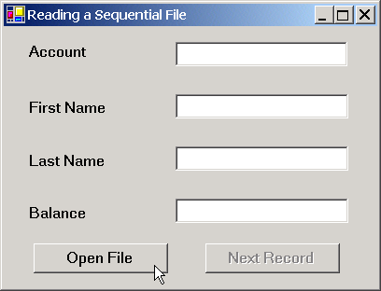
ReadSequentialAccessFile.cs
Program Output
106 ClearTextBoxes();
107
108 // notify user if no Records in file
109 MessageBox.Show( "No more records in file", "",
110 MessageBoxButtons.OK, MessageBoxIcon.Information );
111 }
112
113 } // end method nextButton_Click
114
115 } // end class ReadSequentialAccessFileForm
Tell user there are no more records

Slide 47
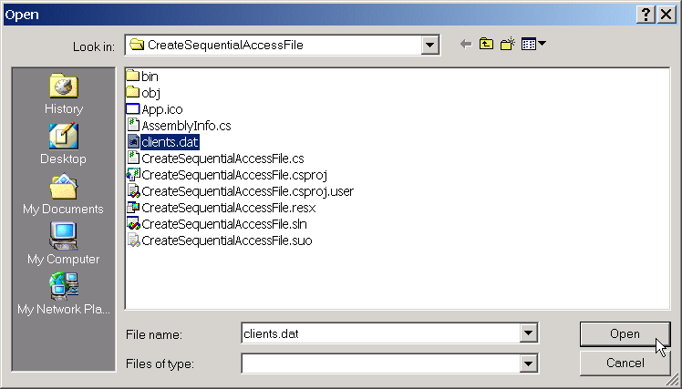
ReadSequentialAccessFile.cs
Program Output

Slide 48
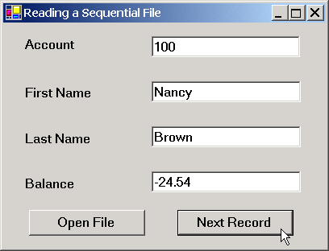
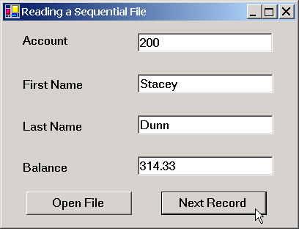
ReadSequentialAccessFile.cs
Program Output

Slide 49
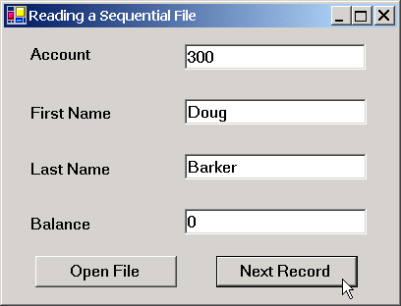
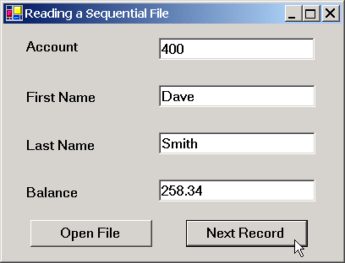
ReadSequentialAccessFile.cs
Program Output

Slide 50
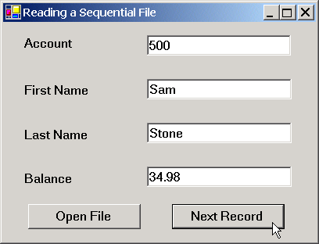
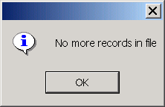
ReadSequentialAccessFile.cs
Program Output

Slide 51
CreditInquiry.cs
1 // Fig. 17.12: CreditInquiry.cs
2 // Read a file sequentially and display contents based on
3 // account type specified by user (credit, debit or zero balances).
4
5 // C# namespaces
6 using System;
7 using System.Drawing;
8 using System.Collections;
9 using System.ComponentModel;
10 using System.Windows.Forms;
11 using System.Data;
12 using System.IO;
13 using System.Runtime.Serialization.Formatters.Binary;
14 using System.Runtime.Serialization;
15
16 // Deitel namespaces
17 using BankLibrary;
18
19 public class CreditInquiryForm : System.Windows.Forms.Form
20 {
21 private System.Windows.Forms.RichTextBox displayTextBox;
22
23 private System.Windows.Forms.Button doneButton;
24 private System.Windows.Forms.Button zeroButton;
25 private System.Windows.Forms.Button debitButton;
26 private System.Windows.Forms.Button creditButton;
27 private System.Windows.Forms.Button openButton;
28
29 private System.ComponentModel.Container components = null;
30
31 // stream through which serializable data are read from file
32 private FileStream input;
33
34 // object for deserializing Record in binary format
35 BinaryFormatter reader = new BinaryFormatter();

Slide 52
CreditInquiry.cs
36
37 // name of file that stores credit, debit and zero balances
38 private string fileName;
39
40 [STAThread]
41 static void Main()
42 {
43 Application.Run( new CreditInquiryForm() );
44 }
45
46 // Visual Studio .NET generated code
47
48 // invoked when user clicks Open File button
49 private void openButton_Click(
50 object sender, System.EventArgs e )
51 {
52 // create dialog box enabling user to open file
53 OpenFileDialog fileChooser = new OpenFileDialog();
54 DialogResult result = fileChooser.ShowDialog();
55
56 // exit event handler if user clicked Cancel
57 if ( result == DialogResult.Cancel )
58 return;
59
60 // get name from user
61 fileName = fileChooser.FileName;
62
63 // show error if user specified invalid file
64 if ( fileName == "" || fileName == null )
65 MessageBox.Show( "Invalid File Name", "Error",
66 MessageBoxButtons.OK, MessageBoxIcon.Error );
User clicked open button
Instantiate OpenFilelDialog
Show OpenFileDialog

Slide 53
CreditInquiry.cs
67 else
68 {
69 // enable all GUI buttons, except for Open file button
70 openButton.Enabled = false;
71 creditButton.Enabled = true;
72 debitButton.Enabled = true;
73 zeroButton.Enabled = true;
74 }
75
76 } // end method openButton_Click
77
78 // invoked when user clicks credit balances,
79 // debit balances or zero balances button
80 private void get_Click( object sender, System.EventArgs e )
81 {
82 // convert sender explicitly to object of type button
83 Button senderButton = ( Button )sender;
84
85 // get text from clicked Button, which stores account type
86 string accountType = senderButton.Text;
87
88 // read and display file information
89 try
90 {
91 // close file from previous operation
92 if ( input != null )
93 input.Close();
94
95 // create FileStream to obtain read access to file
96 input = new FileStream( fileName, FileMode.Open,
97 FileAccess.Read );
98
99 displayTextBox.Text = "The accounts are:\r\n";
100
Button click event handler
Reference to object that sent event
Get text from clicked button
Create read only FileStream for input

Slide 54
CreditInquiry.cs
101 // traverse file until end of file
102 while ( true )
103 {
104 // get next Record available in file
105 Record record = ( Record )reader.Deserialize( input );
106
107 // store record's last field in balance
108 Double balance = record.Balance;
109
110 // determine whether to display balance
111 if ( ShouldDisplay( balance, accountType ) )
112 {
113 // display record
114 string output = record.Account + "\t" +
115 record.FirstName + "\t" + record.LastName +
116 new string( ' ', 6 ) + "\t";
117
118 // display balance with correct monetary format
119 output += String.Format(
120 "{0:F}", balance ) + "\r\n";
121
122 // copy output to screen
123 displayTextBox.Text += output;
124 }
125 }
126 }
127
128 // handle exception when file cannot be closed
129 catch( IOException )
130 {
131 MessageBox.Show( "Cannot Close File", "Error",
132 MessageBoxButtons.OK, MessageBoxIcon.Error );
133 }
134
While loop to read from file
Read input from file

Slide 55
CreditInquiry.cs
135 // handle exception when no more records
136 catch( SerializationException )
137 {
138 // close FileStream if no Records in file
139 input.Close();
140 }
141
142 } // end method get_Click
143
144 // determine whether to display given record
145 private bool ShouldDisplay( double balance, string accountType )
146 {
147 if ( balance > 0 )
148 {
149 // display credit balances
150 if ( accountType == "Credit Balances" )
151 return true;
152 }
153
154 else if ( balance < 0 )
155 {
156 // display debit balances
157 if ( accountType == "Debit Balances" )
158 return true;
159 }
160
161 else // balance == 0
162 {
163 // display zero balances
164 if ( accountType == "Zero Balances" )
165 return true;
166 }
167
No more records exception
Close FileStream
Method to determine whether to display each record in file

Slide 56
CreditInquiry.cs
168 return false;
169
170 } // end method ShouldDisplay
171
172 // invoked when user clicks Done button
173 private void doneButton_Click(
174 object sender, System.EventArgs e )
175 {
176 // determine whether file exists
177 if ( input != null )
178 {
179 // close file
180 try
181 {
182 input.Close();
183 }
184
185 // handle exception if FileStream does not exist
186 catch( IOException )
187 {
188 // notify user of error closing file
189 MessageBox.Show( "Cannot close file", "Error",
190 MessageBoxButtons.OK, MessageBoxIcon.Error);
191 }
192 }
193
194 Application.Exit();
195
196 } // end method doneButton_Click
197
198 } // end class CreditInquiryForm
Done button clicked event handler

Slide 57
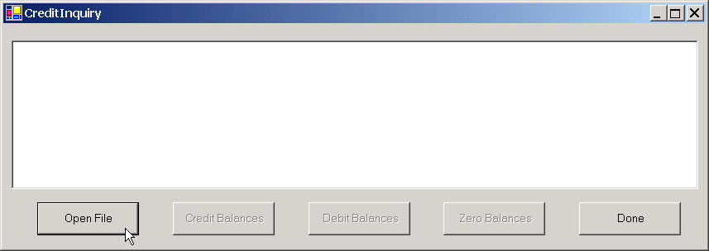

CreditInquiry.cs
Program Output

Slide 58
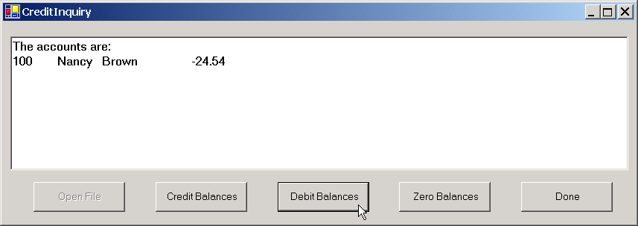
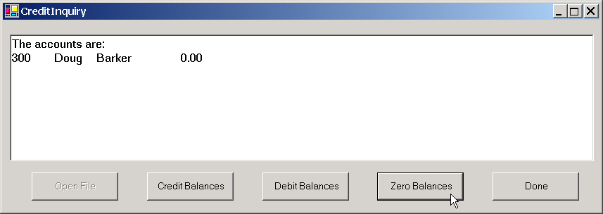
CreditInquiry.cs
Program Output

Slide 59
17.7 Random-Access Files
Allows instant access to information
  Individual records can be accessed directly without searching through large numbers of other records
Must be implemented through the application
Easiest when all records are a fixed length
Data can be inserted without destroying other data in file
Records can be updated without rewriting the entire file
Cannot serialize
  Won’t guarantee a fixed-length record size

Slide 60
17.7 Random-Access Files
0
100
200
300
400
500
byte offsets
100 bytes
100 bytes
100 bytes
100 bytes
100 bytes
100 bytes
Fig. 17.13 Random-access file with fixed-length records.

Slide 61
RandomAccessRecord.cs
1 // Fig. 17.14: RandomAccessRecord.cs
2 // Data-record class for random-access applications.
3
4 using System;
5
6 public class RandomAccessRecord
7 {
8 // length of firstName and lastName
9 private const int CHAR_ARRAY_LENGTH = 15;
10
11 private const int SIZE_OF_CHAR = 2;
12 private const int SIZE_OF_INT32 = 4;
13 private const int SIZE_OF_DOUBLE = 8;
14
15 // length of record
16 public const int SIZE = SIZE_OF_INT32 +
17 2 * ( SIZE_OF_CHAR * CHAR_ARRAY_LENGTH ) + SIZE_OF_DOUBLE;
18
19 // record data
20 private int account;
21 private char[] firstName = new char[ CHAR_ARRAY_LENGTH ];
22 private char[] lastName = new char[ CHAR_ARRAY_LENGTH ];
23 private double balance;
24
25 // default constructor sets members to default values
26 public RandomAccessRecord() : this( 0, "", "", 0.0 )
27 {
28 }
29
Constant to hold record length
Private members for data storage
Set members to default value

Slide 62
RandomAccessRecord.cs
30 // overloaded counstructor sets members to parameter values
31 public RandomAccessRecord( int accountValue,
32 string firstNameValue, string lastNameValue,
33 double balanceValue )
34 {
35 Account = accountValue;
36 FirstName = firstNameValue;
37 LastName = lastNameValue;
38 Balance = balanceValue;
39
40 } // end constructor
41
42 // property Account
43 public int Account
44 {
45 get
46 {
47 return account;
48 }
49
50 set
51 {
52 account = value;
53 }
54
55 } // end property Account
56
57 // property FirstName
58 public string FirstName
59 {
60 get
61 {
62 return new string( firstName );
63 }
64
Set records to parameter values
Account accessor methods
First name accessor methods

Slide 63
RandomAccessRecord.cs
65 set
66 {
67 // determine length of string parameter
68 int stringSize = value.Length;
69
70 // firstName string representation
71 string firstNameString = value;
72
73 // append spaces to string parameter if too short
74 if ( CHAR_ARRAY_LENGTH >= stringSize )
75 {
76 firstNameString = value +
77 new string( ' ', CHAR_ARRAY_LENGTH - stringSize );
78 }
79 else
80 {
81 // remove characters from string parameter if too long
82 firstNameString =
83 value.Substring( 0, CHAR_ARRAY_LENGTH );
84 }
85
86 // convert string parameter to char array
87 firstName = firstNameString.ToCharArray();
88
89 } // end set
90
91 } // end property FirstName
92
93 // property LastName
94 public string LastName
95 {
96 get
97 {
98 return new string( lastName );
99 }
Set accessor assures length is only 15 characters
Get length of string
Add spaces if length is less then 15 characters
Remove characters if length is more then 15 characters
Last name accessor methods

Slide 64
RandomAccessRecord.cs
100
101 set
102 {
103 // determine length of string parameter
104 int stringSize = value.Length;
105
106 // lastName string representation
107 string lastNameString = value;
108
109 // append spaces to string parameter if too short
110 if ( CHAR_ARRAY_LENGTH >= stringSize )
111 {
112 lastNameString = value +
113 new string( ' ', CHAR_ARRAY_LENGTH - stringSize );
114 }
115 else
116 {
117 // remove characters from string parameter if too long
118 lastNameString =
119 value.Substring( 0, CHAR_ARRAY_LENGTH );
120 }
121
122 // convert string parameter to char array
123 lastName = lastNameString.ToCharArray();
124
125 } // end set
126
127 } // end property LastName
128
Set accessor assures length of 15 characters
Get name length
Add spaces if length is less then 15 characters
Remove characters if length is more then 15 characters

Slide 65
RandomAccessRecord.cs
129 // property Balance
130 public double Balance
131 {
132 get
133 {
134 return balance;
135 }
136
137 set
138 {
139 balance = value;
140 }
141
142 } // end property Balance
143
144 } // end class RandomAccessRecord
Balance accessor methods

Slide 66
17.8 Creating a Random-Access File
Use class BinaryWriter instead of serialization
  By attaching a FileStream to it, bytes can be written directly to a file

Slide 67
CreateRandomAccessFile.cs
1 // Fig. 17.15: CreateRandomAccessFile.cs
2 // Creating a random file.
3
4 // C# namespaces
5 using System;
6 using System.IO;
7 using System.Windows.Forms;
8
9 // Deitel namespaces
10 using BankLibrary;
11
12 class CreateRandomAccessFile
13 {
14 // number of records to write to disk
15 private const int NUMBER_OF_RECORDS = 100;
16
17 [STAThread]
18 static void Main(string[] args)
19 {
20 // create random file, then save to disk
21 CreateRandomAccessFile file = new CreateRandomAccessFile();
22 file.SaveFile();
23
24 } // end method Main
25
26 // write records to disk
27 private void SaveFile()
28 {
29 // record for writing to disk
30 RandomAccessRecord blankRecord = new RandomAccessRecord();
31
32 // stream through which serializable data are written to file
33 FileStream fileOutput = null;
34
Create a random file
Save file to disk by invoking method SaveFile
SaveFile method
Create blank record

Slide 68
CreateRandomAccessFile.cs
35 // stream for writing bytes to file
36 BinaryWriter binaryOutput = null;
37
38 // create dialog box enabling user to save file
39 SaveFileDialog fileChooser = new SaveFileDialog();
40 DialogResult result = fileChooser.ShowDialog();
41
42 // get file name from user
43 string fileName = fileChooser.FileName;
44
45 // exit event handler if user clicked Cancel
46 if ( result == DialogResult.Cancel )
47 return;
48
49 // show error if user specified invalid file
50 if ( fileName == "" || fileName == null )
51 MessageBox.Show("Invalid File Name", "Error",
52 MessageBoxButtons.OK, MessageBoxIcon.Error);
53 else
54 {
55 // write records to file
56 try
57 {
58 // create FileStream to hold records
59 fileOutput = new FileStream( fileName,
60 FileMode.Create, FileAccess.Write );
61
62 // set length of file
63 fileOutput.SetLength( RandomAccessRecord.SIZE *
64 NUMBER_OF_RECORDS );
65
66 // create object for writing bytes to file
67 binaryOutput = new BinaryWriter( fileOutput );
68
Create and display SaveFileDialog so user can specify file name and location
Instantiate FileStream with user selected file
Set length of FileStream to the size of a recod times the number of records
Pass FileStream to BinaryWriter to write bytes directly to file

Slide 69
CreateRandomAccessFile.cs
69 // write empty records to file
70 for ( int i = 0; i < NUMBER_OF_RECORDS; i++ )
71 {
72 // set file position pointer in file
73 fileOutput.Position = i * RandomAccessRecord.SIZE;
74
75 // write blank record to file
76 binaryOutput.Write( blankRecord.Account );
77 binaryOutput.Write( blankRecord.FirstName );
78 binaryOutput.Write( blankRecord.LastName );
79 binaryOutput.Write( blankRecord.Balance );
80 }
81
82 // notify user of success
83 MessageBox.Show("File Created", "Success",
84 MessageBoxButtons.OK, MessageBoxIcon.Information);
85 }
86
87 // handle exception if error occurs during writing
88 catch( IOException )
89 {
90 // notify user of error
91 MessageBox.Show( "Cannot write to file", "Error",
92 MessageBoxButtons.OK, MessageBoxIcon.Error );
93 }
94 }
95
Create 100 empty records
Move file position pointer to next write location
Write data to file

Slide 70
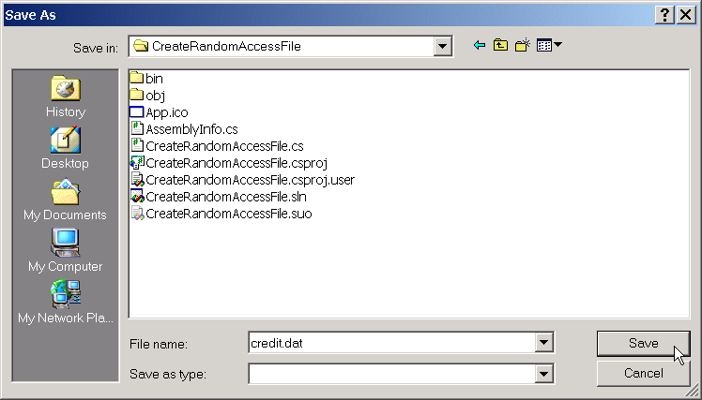
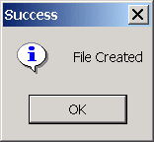
CreateRandomAccessFile.cs
Program Output
96 // close FileStream
97 if ( fileOutput == null )
98 fileOutput.Close();
99
100 // close BinaryWriter
101 if ( binaryOutput == null )
102 binaryOutput.Close();
103
104 } // end method SaveFile
105 } // end class CreateRandomAccessFile
Close Filestream
Close BinaryWriter

Slide 71
17.9 Writing Data Randomly to a Random-Access File

Slide 72
WriteRandomAccessFile.cs
1 // Fig 17.16: WriteRandomAccessFile.cs
2 // Write data to a random-access file.
3
4 // C# namespaces
5 using System;
6 using System.Drawing;
7 using System.Collections;
8 using System.ComponentModel;
9 using System.Windows.Forms;
10 using System.Data;
11 using System.IO;
12
13 // Deitel namespaces
14 using BankLibrary;
15
16 public class WriteRandomAccessFileForm : BankUIForm
17 {
18 private System.Windows.Forms.Button openButton;
19 private System.Windows.Forms.Button enterButton;
20
21 private System.ComponentModel.Container components = null;
22
23 // number of RandomAccessRecords to write to disk
24 private const int NUMBER_OF_RECORDS = 100;
25
26 // stream through which data are written to file
27 private FileStream fileOutput;
28
29 // stream for writing bytes to file
30 private BinaryWriter binaryOutput;
31

Slide 73
WriteRandomAccessFile.cs
32 [STAThread]
33 static void Main()
34 {
35 Application.Run( new WriteRandomAccessFileForm() );
36 }
37
38 // Visual Studio .NET generated code
39
40 // invoked when user clicks Open button
41 private void openButton_Click(
42 object sender, System.EventArgs e )
43 {
44 // create dialog box enabling user to open file
45 OpenFileDialog fileChooser = new OpenFileDialog();
46 DialogResult result = fileChooser.ShowDialog();
47
48 // get file name from user
49 string fileName = fileChooser.FileName;
50
51 // exit event handler if user clicked Cancel
52 if ( result == DialogResult.Cancel )
53 return;
54
55 // show error if user specified invalid file
56 if ( fileName == "" || fileName == null )
57 MessageBox.Show("Invalid File Name", "Error",
58 MessageBoxButtons.OK, MessageBoxIcon.Error);
59 else
60 {
61 // open file if file already exists
62 try
63 {
64 // create FileStream to hold records
65 fileOutput = new FileStream( fileName,
66 FileMode.Open, FileAccess.Write );
Open Button clicked event handler
Instantiate and show OpenFileDialog so user can choose file to write to
Create write only FileStream with user selected file for output

Slide 74
WriteRandomAccessFile.cs
67
68 // create object for writing bytes to file
69 binaryOutput = new BinaryWriter( fileOutput );
70
71 // disable Open button and enable Enter button
72 openButton.Enabled = false;
73 enterButton.Enabled = true;
74 }
75
76 // notify user if file does not exist
77 catch( IOException )
78 {
79 MessageBox.Show("File Does Not Exits", "Error",
80 MessageBoxButtons.OK, MessageBoxIcon.Error);
81 }
82 }
83
84 } // end method openButton_Click
85
86 // invoked when user clicks Enter button
87 private void enterButton_Click(
88 object sender, System.EventArgs e )
89 {
90 // TextBox values string array
91 string[] values = GetTextBoxValues();
92
93 // determine whether TextBox account field is empty
94 if ( values[ ( int )TextBoxIndices.ACCOUNT ] != "" )
95 {
96 // write record to file at appropriate position
97 try
98 {
99 // get account number value from TextBox
100 int accountNumber = Int32.Parse(
101 values[ ( int )TextBoxIndices.ACCOUNT ] );
Create BinaryWriter to write directly to file
Enter clicked event handler, writes data entered to file
Retrieve data from text boxes

Slide 75
WriteRandomAccessFile.cs
102
103 // determine whether accountNumber is valid
104 if ( accountNumber > 0 &&
105 accountNumber <= NUMBER_OF_RECORDS )
106 {
107 // move file position pointer
108 fileOutput.Seek( ( accountNumber - 1 ) *
109 RandomAccessRecord.SIZE, SeekOrigin.Begin );
110
111 // write data to file
112 binaryOutput.Write( accountNumber );
113 binaryOutput.Write(
114 values[ ( int )TextBoxIndices.FIRST ] );
115 binaryOutput.Write(
116 values[ ( int )TextBoxIndices.LAST ] );
117 binaryOutput.Write( Double.Parse( values[
118 ( int )TextBoxIndices.BALANCE ] ) );
119 }
120 else
121 {
122 // notify user if invalid account number
123 MessageBox.Show("Invalid Account Number", "Error",
124 MessageBoxButtons.OK, MessageBoxIcon.Error);
125 }
126 }
127
128 // handle number-format exception
Test if accountNumer is valid
Move file position pointer
Write data to file using BinaryWriter

Slide 76

WriteRandomAccessFile.cs
Program Output
129 catch( FormatException )
130 {
131 // notify user if error occurs when formatting numbers
132 MessageBox.Show("Invalid Balance", "Error",
133 MessageBoxButtons.OK, MessageBoxIcon.Error );
134 }
135 }
136
137 ClearTextBoxes(); // clear text box values
138
139 } // end method enterButton_Click
140
141 } // end class WriteRandomAccessFileForm

Slide 77
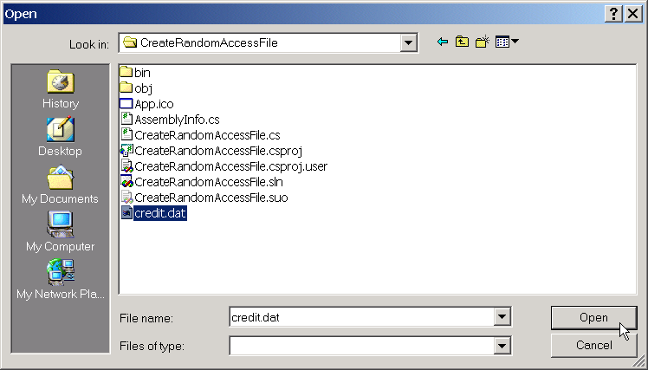
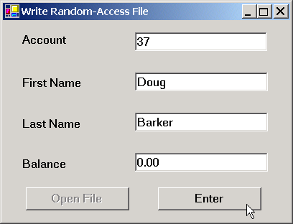
WriteRandomAccessFile.cs
Program Output

Slide 78
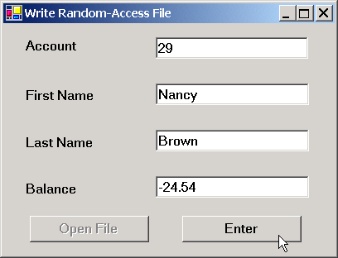
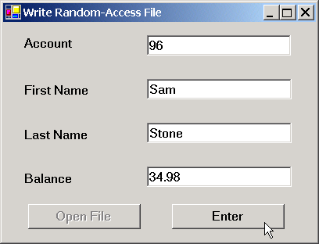
WriteRandomAccessFile.cs
Program Output

Slide 79
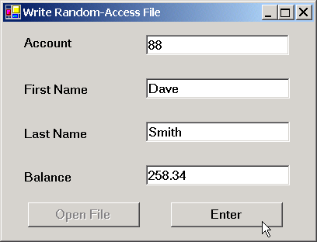
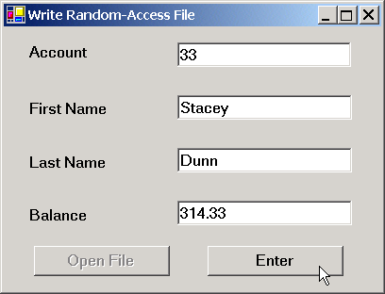
WriteRandomAccessFile.cs
Program Output

Slide 80
17.10 Reading Data Sequentially from a Random-Access File
Use class BinaryReader instead of deserialization
  By attaching a FileStream to it, bytes can be read directly from a file

Slide 81
ReadRandomAccessFile.cs
1 // Fig 17.17: ReadRandomAccessFile.cs
2 // Reads and displays random-access file contents.
3
4 // C# namespaces
5 using System;
6 using System.Drawing;
7 using System.Collections;
8 using System.ComponentModel;
9 using System.Windows.Forms;
10 using System.Data;
11 using System.IO;
12
13 // Deitel namespaces
14 using BankLibrary;
15
16 public class ReadRandomAccessFileForm : BankUIForm
17 {
18 private System.Windows.Forms.Button openButton;
19 private System.Windows.Forms.Button nextButton;
20
21 private System.ComponentModel.Container components = null;
22
23 // stream through which data are read from file
24 private FileStream fileInput;
25
26 // stream for reading bytes from file
27 private BinaryReader binaryInput;
28
29 // index of current record to be displayed
30 private int currentRecordIndex;
31

Slide 82
ReadRandomAccessFile.cs
32 [STAThread]
33 static void Main()
34 {
35 Application.Run( new ReadRandomAccessFileForm() );
36 }
37
38 // Visual Studio .NET generated code
39
40 // invoked when user clicks Open button
41 private void openButton_Click(
42 object sender, System.EventArgs e )
43 {
44 // create dialog box enabling user to open file
45 OpenFileDialog fileChooser = new OpenFileDialog();
46 DialogResult result = fileChooser.ShowDialog();
47
48 // get file name from user
49 string fileName = fileChooser.FileName;
50
51 // exit eventhandler if user clicked Cancel
52 if ( result == DialogResult.Cancel )
53 return;
54
55 // show error if user specified invalid file
56 if ( fileName == "" || fileName == null )
57 MessageBox.Show( "Invalid File Name", "Error",
58 MessageBoxButtons.OK, MessageBoxIcon.Error );
59 else
60 {
61 // create FileStream to obtain read access to file
62 fileInput = new FileStream( fileName,
63 FileMode.Open, FileAccess.Read );
64
Open Button clicked event handler
Instantiate and show OpenFileDialog so user can choose file to read from
Create FileStream with user selected file

Slide 83
ReadRandomAccessFile.cs
65 // use FileStream for BinaryWriter to read bytes from file
66 binaryInput = new BinaryReader( fileInput );
67
68 openButton.Enabled = false; // disable Open button
69 nextButton.Enabled = true; // enable Next button
70
71 currentRecordIndex = 0;
72 ClearTextBoxes();
73 }
74
75 } // end method openButton_Click
76
77 // invoked when user clicks Next button
78 private void nextButton_Click(
79 object sender, System.EventArgs e )
80 {
81 // record to store file data
82 RandomAccessRecord record = new RandomAccessRecord();
83
84 // read record and store data in TextBoxes
85 try
86 {
87 string[] values; // for storing TextBox values
88
89 // get next record available in file
90 while( record.Account == 0 )
91 {
92 // set file position pointer to next record in file
93 fileInput.Seek(
94 currentRecordIndex * RandomAccessRecord.SIZE, 0 );
95
96 currentRecordIndex += 1;
97
Create BinaryReader to read from file
Next button clicked event handler
Instantiate record to store data
Read from file until a nonzero account number is reached
Move file position pointer

Slide 84
ReadRandomAccessFile.cs
98 // read data from record
99 record.Account = binaryInput.ReadInt32();
100 record.FirstName = binaryInput.ReadString();
101 record.LastName = binaryInput.ReadString();
102 record.Balance = binaryInput.ReadDouble();
103 }
104
105 // store record values in temporary string array
106 values = new string[] {
107 record.Account.ToString(),
108 record.FirstName,
109 record.LastName,
110 record.Balance.ToString() };
111
112 // copy string array values to TextBox values
113 SetTextBoxValues( values );
114 }
115
116 // handle exception when no records in file
117 catch( IOException )
118 {
119 // close streams if no records in file
120 fileInput.Close();
121 binaryInput.Close();
122
123 openButton.Enabled = true; // enable Open button
124 nextButton.Enabled = false; // disable Next button
125 ClearTextBoxes();
126
Use BinaryReader to store file data in record
Display records in TextBoxes
No more records exception handler
Close FileStream and BinaryReader

Slide 85

ReadRandomAccessFile.cs
Program Output
127 // notify user if no records in file
128 MessageBox.Show("No more records in file", "",
129 MessageBoxButtons.OK, MessageBoxIcon.Information);
130 }
131
132 } // end method nextButton_Click
133
134 } // end class ReadRandomAccessFileForm
Tell user there are no more records

Slide 86

ReadRandomAccessFile.cs
Program Output

Slide 87
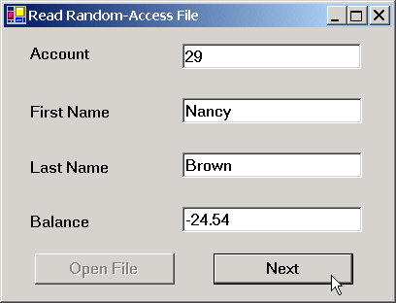
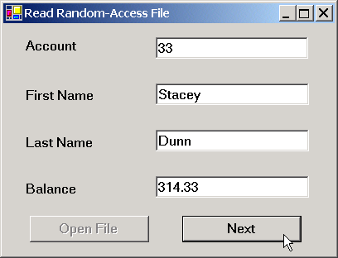
ReadRandomAccessFile.cs
Program Output

Slide 88
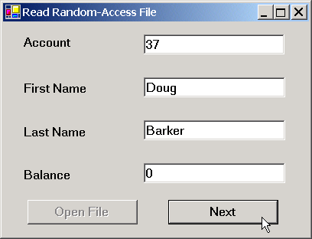
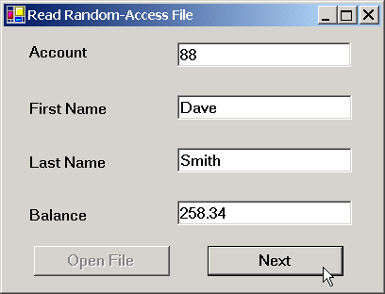
ReadRandomAccessFile.cs
Program Output

Slide 89


ReadRandomAccessFile.cs
Program Output

Slide 90
17.11 Case Study: A Transaction-Processing Program
Transaction-Processing Program
  Maintains a bank’s account information
  Users can add new accounts, update existing accounts and delete accounts
  Class Transaction
    Acts as a proxy:
      Handles all transactions so objects do not have to
      Allows abstraction

Slide 91
Transaction.cs
1 // Fig. 17.18: Transaction.cs
2 // Handles record transactions.
3
4 // C# namespaces
5 using System;
6 using System.IO;
7 using System.Windows.Forms;
8
9 // Deitel namespaces
10 using BankLibrary;
11
12 public class Transaction
13 {
14 // number of records to write to disk
15 private const int NUMBER_OF_RECORDS = 100;
16
17 // stream through which data move to and from file
18 private FileStream file;
19
20 // stream for reading bytes from file
21 private BinaryReader binaryInput;
22
23 // stream for writing bytes to file
24 private BinaryWriter binaryOutput;
25
26 // create/open file containing empty records
27 public void OpenFile( string fileName )
28 {
29 // write empty records to file
30 try
31 {
32 // create FileStream from new file or existing file
33 file = new FileStream( fileName, FileMode.OpenOrCreate );
34
Method to create or open file
Create FileStream from new or existing file

Slide 92
Transaction.cs
35 // use FileStream for BinaryWriter to read bytes from file
36 binaryInput = new BinaryReader( file );
37
38 // use FileStream for BinaryWriter to write bytes to file
39 binaryOutput = new BinaryWriter( file );
40
41 // determine whether file has just been created
42 if ( file.Length == 0 )
43 {
44 // record to be written to file
45 RandomAccessRecord blankRecord =
46 new RandomAccessRecord();
47
48 // new record can hold NUMBER_OF_RECORDS records
49 file.SetLength( RandomAccessRecord.SIZE *
50 NUMBER_OF_RECORDS );
51
52 // write blank records to file
53 for ( int i = 0; i < NUMBER_OF_RECORDS; i++ )
54 {
55 // move file-position pointer to next position
56 file.Position = i * RandomAccessRecord.SIZE;
57
58 // write blank record to file
59 binaryOutput.Write( blankRecord.Account );
60 binaryOutput.Write( blankRecord.FirstName );
61 binaryOutput.Write( blankRecord.LastName );
62 binaryOutput.Write( blankRecord.Balance );
63 }
64 }
65 }
66
Create BinaryWriter and BinaryReader from FileStream
If the file is new, fill it with empty records

Slide 93
Transaction.cs
67 // notify user of error during writing of blank records
68 catch( IOException )
69 {
70 MessageBox.Show("Cannot create file", "Error",
71 MessageBoxButtons.OK, MessageBoxIcon.Error);
72 }
73
74 } // end method OpenFile
75
76 // retrieve record depending on whether account is valid
77 public RandomAccessRecord GetRecord( string accountValue )
78 {
79 // store file data associated with account in record
80 try
81 {
82 // record to store file data
83 RandomAccessRecord record = new RandomAccessRecord();
84
85 // get value from TextBox's account field
86 int accountNumber = Int32.Parse( accountValue );
87
88 // if account is invalid, do not read data
89 if ( accountNumber < 1 ||
90 accountNumber > NUMBER_OF_RECORDS )
91 {
92 // set record's account field with account number
93 record.Account = accountNumber;
94 }
95
96 // get data from file if account is valid
97 else
98 {
99 // locate position in file where record exists
100 file.Seek( ( accountNumber - 1 ) *
101 RandomAccessRecord.SIZE, 0 );
Get record associated with account number
Instantiate record to hold data
Find position of record

Slide 94
Transaction.cs
102
103 // read data from record
104 record.Account = binaryInput.ReadInt32();
105 record.FirstName = binaryInput.ReadString();
106 record.LastName = binaryInput.ReadString();
107 record.Balance = binaryInput.ReadDouble();
108 }
109
110 return record;
111 }
112
113 // notify user of error during reading
114 catch( IOException )
115 {
116 MessageBox.Show( "Cannot read file", "Error",
117 MessageBoxButtons.OK, MessageBoxIcon.Error );
118 }
119
120 return null;
121
122 } // end method GetRecord;
123
124 // add record to file at position determined by accountNumber
125 public bool AddRecord(
126 RandomAccessRecord record, int accountNumber )
127 {
128 // write record to file
129 try
130 {
131 // move file position pointer to appropriate position
132 file.Seek( ( accountNumber - 1 ) *
133 RandomAccessRecord.SIZE, 0 );
134
Store file data in record
Return the record
Method to insert record
Use account number to determine where to enter record

Slide 95
Transaction.cs
135 // write data to file
136 binaryOutput.Write(record.Account);
137 binaryOutput.Write(record.FirstName);
138 binaryOutput.Write(record.LastName);
139 binaryOutput.Write(record.Balance);
140 }
141
142 // notify user if error occurs during writing
143 catch( IOException )
144 {
145 MessageBox.Show( "Error Writing To File", "Error",
146 MessageBoxButtons.OK, MessageBoxIcon.Error );
147
148 return false; // failure
149 }
150
151 return true; // success
152
153 } // end method AddRecord
154
155 } // end class Transaction
Write data to file
If error occurs, notify user

Slide 96
TransactionProcessor.cs
1 // Fig. 17.19: TransactionProcessor.cs
2 // MDI parent for transaction-processor application.
3
4 using System;
5 using System.Drawing;
6 using System.Collections;
7 using System.ComponentModel;
8 using System.Windows.Forms;
9 using System.Data;
10
11 public class TransactionProcessorForm
12 : System.Windows.Forms.Form
13 {
14 private System.ComponentModel.Container components = null;
15 private System.Windows.Forms.MdiClient MdiClient1;
16
17 // reference to StartDialog
18 private StartDialogForm startDialog;
19
20 // constructor
21 public TransactionProcessorForm()
22 {
23 // required for Windows Form Designer support
24 InitializeComponent();
25
26 startDialog = new StartDialogForm();
27 startDialog.MdiParent = this;
28 startDialog.Show();
29 }
30

Slide 97
TransactionProcessor.cs
31 [STAThread]
32 static void Main()
33 {
34 Application.Run( new TransactionProcessorForm() );
35 }
36
37 // Visual Studio .NET generated code
38
39 } // end class TransactionProcessorForm

Slide 98
StartDialog.cs
1 // Fig. 17.20: StartDialog.cs
2 // Initial dialog box displayed to user. Provides buttons for
3 // creating/opening file and for adding, updating and removing
4 // records from file.
5
6 // C# namespaces
7 using System;
8 using System.Drawing;
9 using System.Collections;
10 using System.ComponentModel;
11 using System.Windows.Forms;
12
13 // Deitel namespaces
14 using BankLibrary;
15
16 public delegate void MyDelegate();
17
18 public class StartDialogForm : System.Windows.Forms.Form
19 {
20 private System.Windows.Forms.Button updateButton;
21 private System.Windows.Forms.Button newButton;
22 private System.Windows.Forms.Button deleteButton;
23 private System.Windows.Forms.Button openButton;
24
25 private System.ComponentModel.Container components = null;
26
27 // reference to dialog box for adding record
28 private NewDialogForm newDialog;
29
30 // reference to dialog box for updating record
31 private UpdateDialogForm updateDialog;
32
33 // reference to dialog box for removing record
34 private DeleteDialogForm deleteDialog;
35

Slide 99
StartDialog.cs
36 // reference to object that handles transactions
37 private Transaction transactionProxy;
38
39 // Visual Studio .NET generated code
40
41 // invoked when user clicks New/Open File button
42 private void openButton_Click(
43 object sender, System.EventArgs e )
44 {
45 // create dialog box enabling user to create or open file
46 OpenFileDialog fileChooser = new OpenFileDialog();
47 DialogResult result;
48 string fileName;
49
50 // enable user to create file if file does not exist
51 fileChooser.Title = "Create File / Open File";
52 fileChooser.CheckFileExists = false;
53
54 // show dialog box to user
55 result = fileChooser.ShowDialog();
56
57 // exit event handler if user clicked Cancel
58 if ( result == DialogResult.Cancel )
59 return;
60
61 // get file name from user
62 fileName = fileChooser.FileName;
63
64 // show error if user specified invalid file
65 if ( fileName == "" || fileName == null )
66 MessageBox.Show( "Invalid File Name", "Error",
67 MessageBoxButtons.OK, MessageBoxIcon.Error );
68
69 // open or create file if user specified valid file
Open button clicked method
Create dialog box so user can select file
Show dialog box

Slide 100
StartDialog.cs
70 else
71 {
72 // create Transaction with specified file
73 transactionProxy = new Transaction();
74 transactionProxy.OpenFile( fileName );
75
76 // enable GUI buttons except for New/Open File button
77 newButton.Enabled = true;
78 updateButton.Enabled = true;
79 deleteButton.Enabled = true;
80 openButton.Enabled = false;
81
82 // instantiate dialog box for creating records
83 newDialog = new NewDialogForm( transactionProxy,
84 new MyDelegate( ShowStartDialog ) );
85
86 // instantiate dialog box for updating records
87 updateDialog = new UpdateDialogForm( transactionProxy,
88 new MyDelegate( ShowStartDialog ) );
89
90 // instantiate dialog box for removing records
91 deleteDialog = new DeleteDialogForm( transactionProxy,
92 new MyDelegate( ShowStartDialog ) );
93
94 // set StartDialog as MdiParent for dialog boxes
95 newDialog.MdiParent = this.MdiParent;
96 updateDialog.MdiParent = this.MdiParent;
97 deleteDialog.MdiParent = this.MdiParent;
98 }
99
100 } // end method openButton_Click
101
Instantiate class Transaction object
Create or open specified file
Create new, update and delete child menus

Slide 101
StartDialog.cs
102 // invoked when user clicks New Record button
103 private void newButton_Click(
104 object sender, System.EventArgs e )
105 {
106 Hide(); // hide StartDialog
107 newDialog.Show(); // show NewDialog
108
109 } // end method newButton_Click
110
111 private void updateButton_Click(
112 object sender, System.EventArgs e )
113 {
114 Hide(); // hide StartDialog
115 updateDialog.Show(); // show UpdateDialog
116
117 } // end method updateButton_Click
118
119 private void deleteButton_Click(
120 object sender, System.EventArgs e )
121 {
122 Hide(); // hide StartDialog
123 deleteDialog.Show(); // show DeleteDialog
124
125 } // end method deleteButton_Click
126
127 protected void ShowStartDialog()
128 {
129 Show();
130 }
131
132 } // end class StartDialogForm
Method to allow user to create records in the file
Method to allow user to update a record
Method to allow user to delete a record
Displays StartDialog GUI

Slide 102
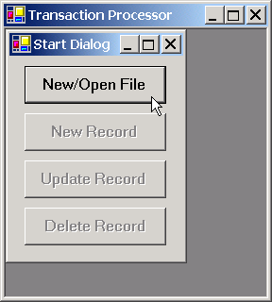
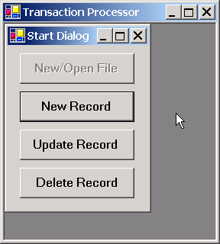
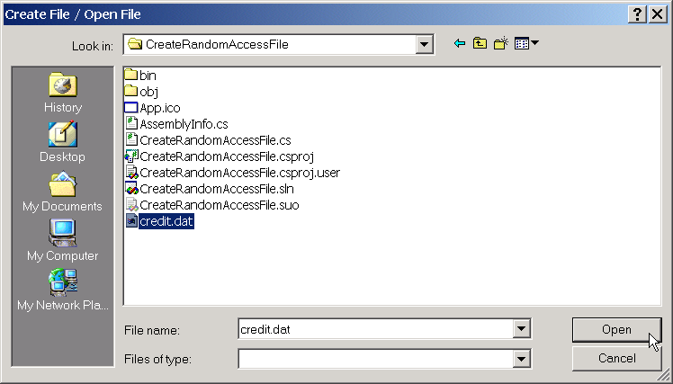
StartDialog.cs
Program Output

Slide 103
UpdateDialog.cs
1 // Fig. 17.22: UpdateDialog.cs
2 // Enables user to update records in file.
3
4 // C# namespaces
5 using System;
6 using System.Drawing;
7 using System.Collections;
8 using System.ComponentModel;
9 using System.Windows.Forms;
10
11 // Deitel namespaces
12 using BankLibrary;
13
14 public class UpdateDialogForm : BankUIForm
15 {
16 private System.Windows.Forms.Label transactionLabel;
17 private System.Windows.Forms.TextBox transactionTextBox;
18
19 private System.Windows.Forms.Button saveButton;
20 private System.Windows.Forms.Button cancelButton;
21
22 private System.ComponentModel.Container components = null;
23
24 // reference to object that handles transactions
25 private Transaction transactionProxy;
26
27 // delegate for method that displays previous window
28 private MyDelegate showPreviousWindow;
29

Slide 104
UpdateDialog.cs
30 // initialize components and set members to parameter values
31 public UpdateDialogForm(
32 Transaction transactionProxyValue,
33 MyDelegate delegateValue )
34 {
35 InitializeComponent();
36 showPreviousWindow = delegateValue;
37
38 // instantiate object that handles transactions
39 transactionProxy = transactionProxyValue;
40 }
41
42 // Visual Studio .NET generated code
43
44 // invoked when user enters text in account TextBox
45 private void accountTextBox_KeyDown(
46 object sender, System.Windows.Forms.KeyEventArgs e )
47 {
48 // determine whether user pressed Enter key
49 if ( e.KeyCode == Keys.Enter )
50 {
51 // retrieve record associated with account from file
52 RandomAccessRecord record =
53 transactionProxy.GetRecord( GetTextBoxValues()
54 [ ( int )TextBoxIndices.ACCOUNT ] );
55
56 // return if record does not exist
57 if ( record == null )
58 return;
59
Display record contents
Retrieve the record

Slide 105
UpdateDialog.cs
60 // determine whether record is empty
61 if ( record.Account != 0 )
62 {
63 // store record values in string array
64 string[] values = {
65 record.Account.ToString(),
66 record.FirstName.ToString(),
67 record.LastName.ToString(),
68 record.Balance.ToString() };
69
70 // copy string array value to TextBox values
71 SetTextBoxValues( values );
72 transactionTextBox.Text = "[Charge or Payment]";
73
74 }
75 else
76 {
77 // notify user if record does not exist
78 MessageBox.Show(
79 "Record Does Not Exist", "Error",
80 MessageBoxButtons.OK, MessageBoxIcon.Error );
81 }
82 }
83
84 } // end method accountTextBox_KeyDown
85
86 // invoked when user enters text in transaction TextBox
87 private void transactionTextBox_KeyDown(
88 object sender, System.Windows.Forms.KeyEventArgs e )
89 {
90 // determine whether user pressed Enter key
91 if ( e.KeyCode == Keys.Enter )
92 {
If the record is not empty, display its contents in TextBoxes
Add user-specified transaction to balance

Slide 106
UpdateDialog.cs
93 // calculate balance using transaction TextBox value
94 try
95 {
96 // retrieve record associated with account from file
97 RandomAccessRecord record =
98 transactionProxy.GetRecord( GetTextBoxValues()
99 [ ( int )TextBoxIndices.ACCOUNT ] );
100
101 // get transaction TextBox value
102 double transactionValue =
103 Double.Parse( transactionTextBox.Text );
104
105 // calculate new balance (old balance + transaction)
106 double newBalance =
107 record.Balance + transactionValue;
108
109 // store record values in string array
110 string[] values = {
111 record.Account.ToString(),
112 record.FirstName.ToString(),
113 record.LastName.ToString(),
114 newBalance.ToString() };
115
116 // copy string array value to TextBox values
117 SetTextBoxValues( values );
118
119 // clear transaction TextBox
120 transactionTextBox.Text = "";
121 }
122

Slide 107
UpdateDialog.cs
123 // notify user if error occurs in parameter mismatch
124 catch( FormatException )
125 {
126 MessageBox.Show(
127 "Invalid Transaction", "Error",
128 MessageBoxButtons.OK, MessageBoxIcon.Error );
129 }
130 }
131
132 } // end method transactionTextBox_KeyDown
133
134 // invoked when user clicks Save button
135 private void saveButton_Click(
136 object sender, System.EventArgs e )
137 {
138 RandomAccessRecord record =
139 transactionProxy.GetRecord( GetTextBoxValues()
140 [ ( int )TextBoxIndices.ACCOUNT ] );
141
142 // if record exists, update in file
143 if ( record != null )
144 UpdateRecord( record );
145
146 Hide();
147 ClearTextBoxes();
148 showPreviousWindow();
149
150 } // end method saveButton_Click
151
Method to save changes the user made

Slide 108
UpdateDialog.cs
152 // invoked when user clicks Cancel button
153 private void cancelButton_Click(
154 object sender, System.EventArgs e )
155 {
156 Hide();
157 ClearTextBoxes();
158 showPreviousWindow();
159
160 } // end method cancelButton_Click
161
162 // update record in file at position specified by accountNumber
163 public void UpdateRecord( RandomAccessRecord record )
164 {
165 // store TextBox values in record and write record to file
166 try
167 {
168 int accountNumber = record.Account;
169 string[] values = GetTextBoxValues();
170
171 // store values in record
172 record.Account = accountNumber;
173 record.FirstName =
174 values[ ( int )TextBoxIndices.FIRST ];
175 record.LastName =
176 values[ ( int )TextBoxIndices.LAST ];
177 record.Balance =
178 Double.Parse(
179 values[ ( int )TextBoxIndices.BALANCE ] );
180
181 // add record to file
182 if ( transactionProxy.AddRecord(
183 record, accountNumber ) == false )
184
185 return; // if error
186 }
Method to update the record
Add record to file

Slide 109
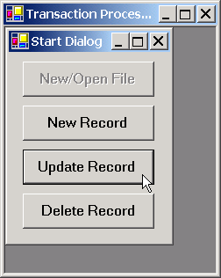
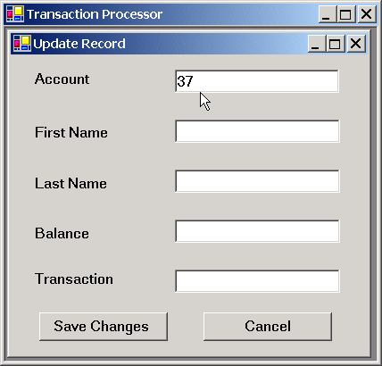
UpdateDialog.cs
Program Output
187
188 // notify user if error occurs in parameter mismatch
189 catch( FormatException )
190 {
191 MessageBox.Show( "Invalid Balance", "Error",
192 MessageBoxButtons.OK, MessageBoxIcon.Error );
193
194 return;
195 }
196
197 MessageBox.Show( "Record Updated", "Success",
198 MessageBoxButtons.OK,
199 MessageBoxIcon.Information );
200
201 } // end method UpdateRecord
202
203 } // end class UpdateDialogForm

Slide 110
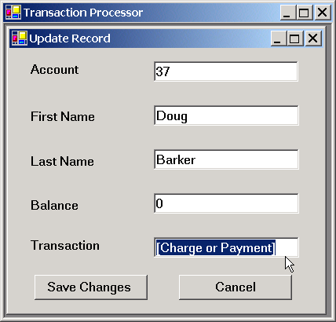
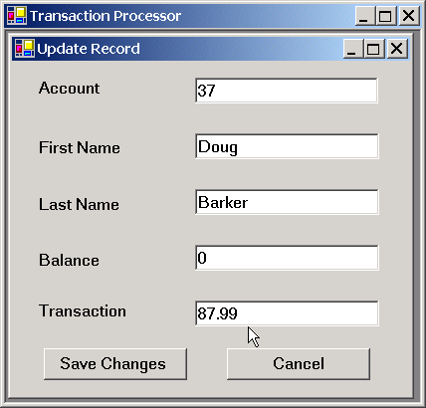
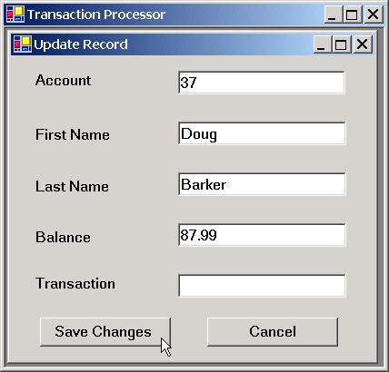
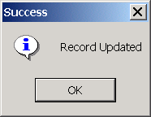
UpdateDialog.cs
Program Output

Slide 111
NewDialog.cs
1 // Fig. 17.21: NewDialog.cs
2 // Enables user to insert new record into file.
3
4 // C# namespaces
5 using System;
6 using System.Drawing;
7 using System.Collections;
8 using System.ComponentModel;
9 using System.Windows.Forms;
10
11 // Deitel namespaces
12 using BankLibrary;
13
14 public class NewDialogForm : BankUIForm
15 {
16 private System.Windows.Forms.Button saveButton;
17 private System.Windows.Forms.Button cancelButton;
18
19 private System.ComponentModel.Container components = null;
20
21 // reference to object that handles transactions
22 private Transaction transactionProxy;
23
24 // delegate for method that displays previous window
25 public MyDelegate showPreviousWindow;
26
27 // constructor
28 public NewDialogForm( Transaction transactionProxyValue,
29 MyDelegate delegateValue )
30 {
31 InitializeComponent();
32 showPreviousWindow = delegateValue;
33

Slide 112
NewDialog.cs
34 // instantiate object that handles transactions
35 transactionProxy = transactionProxyValue;
36 }
37
38 // Visual Studio .NET generated code
39
40 // invoked when user clicks Cancel button
41 private void cancelButton_Click(
42 object sender, System.EventArgs e )
43 {
44 Hide();
45 ClearTextBoxes();
46 showPreviousWindow();
47
48 } // end method cancelButton_Click
49
50 // invoked when user clicks Save As button
51 private void saveButton_Click(
52 object sender, System.EventArgs e )
53 {
54 RandomAccessRecord record =
55 transactionProxy.GetRecord( GetTextBoxValues()
56 [ ( int )TextBoxIndices.ACCOUNT ] );
57
58 // if record exists, add it to file
59 if ( record != null )
60 InsertRecord( record );
61
62 Hide();
63 ClearTextBoxes();
64 showPreviousWindow();
65
66 } // end method saveButton_Click
67
Method to write record to disk
Get empty record
Call method to insert record

Slide 113
NewDialog.cs
68 // insert record in file at position specified by accountNumber
69 private void InsertRecord( RandomAccessRecord record )
70 {
71 //store TextBox values in string array
72 string[] textBoxValues = GetTextBoxValues();
73
74 // store TextBox account field
75 int accountNumber = Int32.Parse(
76 textBoxValues[ ( int )TextBoxIndices.ACCOUNT ] );
77
78 // notify user and return if record account is not empty
79 if ( record.Account != 0 )
80 {
81 MessageBox.Show(
82 "Record Already Exists or Invalid Number", "Error",
83 MessageBoxButtons.OK, MessageBoxIcon.Error);
84
85 return;
86 }
87
88 // store values in record
89 record.Account = accountNumber;
90 record.FirstName =
91 textBoxValues[ ( int )TextBoxIndices.FIRST];
92 record.LastName =
93 textBoxValues[ ( int )TextBoxIndices.LAST];
94 record.Balance = Double.Parse(
95 textBoxValues[ ( int )TextBoxIndices.BALANCE ] );
96
97 // add record to file
98 try
99 {
100 if ( transactionProxy.AddRecord(
101 record, accountNumber ) == false )
Method to insert record into file
If the record already exists, tell the user
If location is empty, add the record

Slide 114
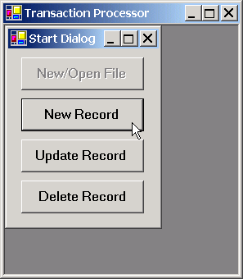
NewDialog.cs
Program Output
102
103 return; // if error
104 }
105
106 // notify user if error occurs in parameter mismatch
107 catch( FormatException )
108 {
109 MessageBox.Show( "Invalid Balance", "Error",
110 MessageBoxButtons.OK, MessageBoxIcon.Error );
111 }
112
113 MessageBox.Show( "Record Created", "Success",
114 MessageBoxButtons.OK, MessageBoxIcon.Information );
115
116 } // end method InsertRecord
117
118 } // end class NewDialogForm

Slide 115


NewDialog.cs
Program Output

Slide 116
DeleteDialog.cs
1 // Fig. 17.23: DeleteDialog.cs
2 // Enables user to delete records in file.
3
4 // C# namespaces
5 using System;
6 using System.Drawing;
7 using System.Collections;
8 using System.ComponentModel;
9 using System.Windows.Forms;
10
11 // Deitel namespaces
12 using BankLibrary;
13
14 public class DeleteDialogForm : System.Windows.Forms.Form
15 {
16 private System.Windows.Forms.Label accountLabel;
17 private System.Windows.Forms.TextBox accountTextBox;
18
19 private System.Windows.Forms.Button deleteButton;
20 private System.Windows.Forms.Button cancelButton;
21
22 private System.ComponentModel.Container components = null;
23
24 // reference to object that handles transactions
25 private Transaction transactionProxy;
26
27 // delegate for method that displays previous window
28 private MyDelegate showPreviousWindow;
29
30 // initialize components and set members to parameter values
31 public DeleteDialogForm( Transaction transactionProxyValue,
32 MyDelegate delegateValue)
33 {
34 InitializeComponent();
35 showPreviousWindow = delegateValue;

Slide 117
DeleteDialog.cs
36
37 // instantiate object that handles transactions
38 transactionProxy = transactionProxyValue;
39 }
40
41 // Visual Studio .NET generated code
42
43 // invoked when user clicks Delete Record button
44 private void deleteButton_Click(
45 object sender, System.EventArgs e)
46 {
47 RandomAccessRecord record =
48 transactionProxy.GetRecord( accountTextBox.Text );
49
50 // if record exists, delete it in file
51 if ( record != null )
52 DeleteRecord( record );
53
54 this.Hide();
55 showPreviousWindow();
56
57 } // end method deleteButton_Click
58
59 // invoked when user clicks Cancel button
60 private void cancelButton_Click(
61 object sender, System.EventArgs e)
62 {
63 this.Hide();
64 showPreviousWindow();
65
66 } // end method cancelButton_Click
67
Method to delete a record

Slide 118
DeleteDialog.cs
68 // delete record in file at position specified by accountNumber
69 public void DeleteRecord( RandomAccessRecord record )
70 {
71 int accountNumber = record.Account;
72
73 // display error message if record does not exist
74 if ( record.Account == 0 )
75 {
76 MessageBox.Show( "Record Does Not Exist", "Error",
77 MessageBoxButtons.OK, MessageBoxIcon.Error );
78 accountTextBox.Clear();
79
80 return;
81 }
82
83 // create blank record
84 record = new RandomAccessRecord();
85
86 // write over file record with empty record
87 if ( transactionProxy.AddRecord(
88 record, accountNumber ) == true )
89
90 // notify user of successful deletion
91 MessageBox.Show( "Record Deleted", "Success",
92 MessageBoxButtons.OK, MessageBoxIcon.Information );
Method to delete record
Test if record exists
If record exists, create an empty one and overwrite existing one

Slide 119



DeleteDialog.cs
Program Output
93 else
94
95 // notify user of failure
96 MessageBox.Show(
97 "Record could not be deleted", "Error",
98 MessageBoxButtons.OK, MessageBoxIcon.Error );
99
100 accountTextBox.Clear();
101
102 } // end method DeleteRecord
103
104 } // end class DeleteDialogForm

